Slide 1
Time Series with ARIMAS
MSDS 7333
Brad Blanchard
bblanchard@smu.edu

Slide 2
ARIMAS
AutoRegressive (p)
Integrated (d)
Moving Average (q)

Slide 3
My my my, that’s a lot of fancy words
Yes
AutoRegressive
Current prediction depends on the past results
Similar to a Markov chain, but can be longer than 1 step
Integrated
Not only is the past result important, but the DIFFERENCES between the past results are important
Moving Average
The average of previous results is also important.

Slide 4
Where to start
ARIMA is really a group of models with three parameters:
p: autoregressive part
d: Integrated part
q: Moving average part
The trick is to find the right (p,d,q) combination to properly fit your model.
Thanks Capt. Obvious!

Slide 5
Requirements
Time Series
Linear time only (sorry Special Relativity)
The series must be stationary
No trends
No seasonal patterns
Really? Yeah, really
This seems like a very strict requirement
Yep

Slide 6
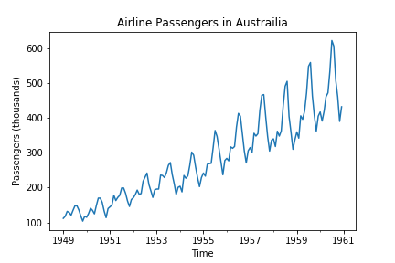
So how do we model something like this?
It has a trend
It has a seasonal Pattern
Pretty sure it is not stationary

Slide 7
Make it stationary!
What does stationary mean anyway
Separate lecture
Short answer: Apply Dickey-Fuller Test
The test looks to see if the rolling mean increases (or decreases) – which is a measure of stationarity
Shorter answer: No Trends!

Slide 8
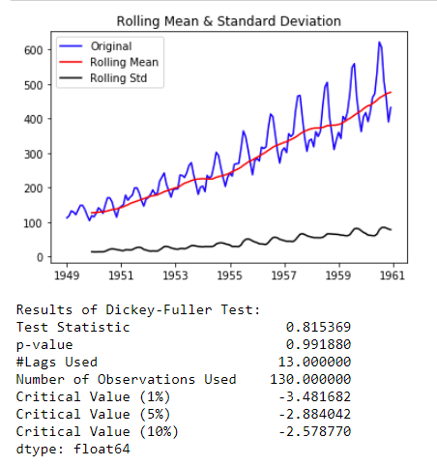
Look at our Example
Obvious Trend (NON STATIONARY!)
Test Statistic is greater than critical value(s)
‘Lags’ is just the number of values to compute rolling statistics. In this case 12(+1)

Slide 9
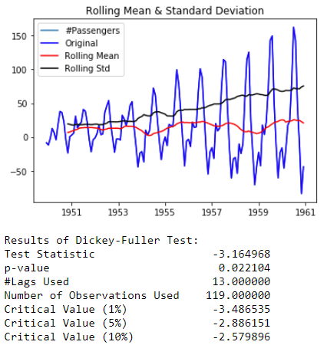
Let’s get rid of the mean
Hmm there still seems to be an increasing pattern over time, but it passes the stationary test!!
DANGER WILL ROBINSON!!!

Slide 10
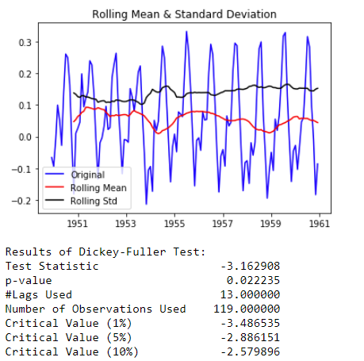
Much better after log transform
Still need to deal with our seasonality!
Notice the stats didn’t actually change!
Even though we’ve shifted the pattern
from ever-spreading to truly a seasonal
cycle (be careful when you do these
transforms, we do them for visual
reasons and not for statistical ones)

Slide 11
But why 12 for moving average?
Seasonality to Data
Using 5 doesn’t work as well (this is highly dependent on your data and its context)
Using the rolling average is important

Slide 12
So we got the series stationary now what!
Time to find p, d, q
Use intuition
Use high explosive brute force

Slide 13
Intuition Method
Use Autocorrelation, Partial Autocorrelation

Slide 14
Rules for ‘d’
Identifying the order of differencing and the constant:
Rule 1: If the series has positive autocorrelations out to a high number of lags (say, 10 or more), then it probably needs a higher order of differencing.
Rule 2: If the lag-1 autocorrelation is zero or negative, or the autocorrelations are all small and patternless, then the series does not need a higher order of differencing. If the lag-1 autocorrelation is -0.5 or more negative, the series may be overdifferenced. BEWARE OF OVERDIFFERENCING.
Rule 3: The optimal order of differencing is often the order of differencing at which the standard deviation is lowest. (Not always, though. Slightly too much or slightly too little differencing can also be corrected with AR or MA terms. See rules 6 and 7.)
Rule 4: A model with no orders of differencing assumes that the original series is stationary (among other things, mean-reverting). A model with one order of differencing assumes that the original series has a constant average trend (e.g. a random walk or SES-type model, with or without growth). A model with two orders of total differencing assumes that the original series has a time-varying trend (e.g. a random trend or LES-type model).
Rule 5: A model with no orders of differencing normally includes a constant term (which allows for a non-zero mean value). A model with two orders of total differencing normally does not include a constant term. In a model with one order of total differencing, a constant term should be included if the series has a non-zero average trend.

Slide 15
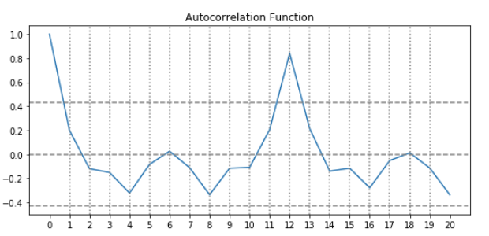
‘d’ examples
Rule 1: No. (almost immediately drops below UCL)
Rule 2: Yes. At label 1 the value is ~ 0
Identifying the order of differencing and the constant:
Rule 1: If the series has positive autocorrelations out to a high number of lags (say, 10 or more), then it probably needs a higher order of differencing.
Rule 2: If the lag-1 autocorrelation is zero or negative, or the autocorrelations are all small and patternless, then the series does not need a higher order of differencing. If the lag-1 autocorrelation is -0.5 or more negative, the series may be overdifferenced. BEWARE OF OVERDIFFERENCING.
d = 0

Slide 16
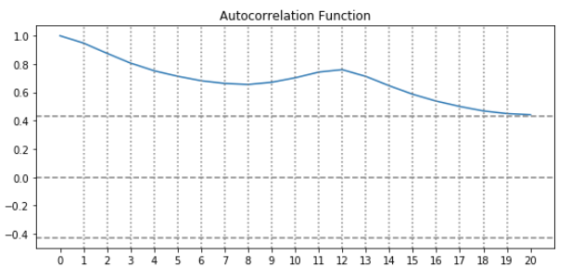
‘d’ example (raw airline population)
Rule 1: Yes. (above UCL to 20)
Rule 2: No. At label 1 the value is ~2x UCL
Identifying the order of differencing and the constant:
Rule 1: If the series has positive autocorrelations out to a high number of lags (say, 10 or more), then it probably needs a higher order of differencing.
Rule 2: If the lag-1 autocorrelation is zero or negative, or the autocorrelations are all small and patternless, then the series does not need a higher order of differencing. If the lag-1 autocorrelation is -0.5 or more negative, the series may be overdifferenced. BEWARE OF OVERDIFFERENCING.
d >= 1

Slide 17
Rules for ‘p’, ‘q’
Identifying the numbers of AR and MA terms:
Rule 6: If the partial autocorrelation function (PACF) of the differenced series displays a sharp cutoff and/or the lag-1 autocorrelation is positive--i.e., if the series appears slightly "underdifferenced"--then consider adding one or more AR terms to the model. The lag beyond which the PACF cuts off is the indicated number of AR terms.
Rule 7: If the autocorrelation function (ACF) of the differenced series displays a sharp cutoff and/or the lag-1 autocorrelation is negative--i.e., if the series appears slightly "overdifferenced"--then consider adding an MA term to the model. The lag beyond which the ACF cuts off is the indicated number of MA terms.
Rule 8: It is possible for an AR term and an MA term to cancel each other's effects, so if a mixed AR-MA model seems to fit the data, also try a model with one fewer AR term and one fewer MA term--particularly if the parameter estimates in the original model require more than 10 iterations to converge. BEWARE OF USING MULTIPLE AR TERMS AND MULTIPLE MA TERMS IN THE SAME MODEL.
Rule 9: If there is a unit root in the AR part of the model--i.e., if the sum of the AR coefficients is almost exactly 1--you should reduce the number of AR terms by one and increase the order of differencing by one.
Rule 10: If there is a unit root in the MA part of the model--i.e., if the sum of the MA coefficients is almost exactly 1--you should reduce the number of MA terms by one and reduce the order of differencing by one.
Rule 11: If the long-term forecasts* appear erratic or unstable, there may be a unit root in the AR or MA coefficients.

Slide 18
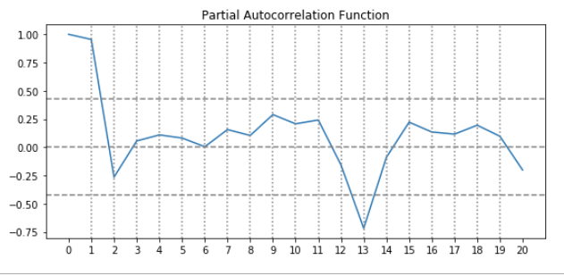
Example
+1 AR term (rule 6)
Rule 6: If the partial autocorrelation function (PACF) of the differenced series displays a sharp cutoff and/or the lag-1 autocorrelation is positive--i.e., if the series appears slightly "underdifferenced"--then consider adding one or more AR terms to the model. The lag beyond which the PACF cuts off is the indicated number of AR terms.

Slide 19
Brute Force (Grid Search)
Generally the parameters p,d,q are between 0 and 3
So we only need 64 runs to get the best fit (4 x 4 x 4)*
Use them all in a for loop.
*48 runs if you’re strictly adhering to Rule 8: It is possible for an AR term and an MA term to cancel each other's effects, so if a mixed AR-MA model seems to fit the data, also try a model with one fewer AR term and one fewer MA term--particularly if the parameter estimates in the original model require more than 10 iterations to converge. BEWARE OF USING MULTIPLE AR TERMS AND MULTIPLE MA TERMS IN THE SAME MODEL.

Slide 20
But wait
ARIMA is nice as there are only 3 parameters that take on discrete values (i.e., only integers, no floats)
Linear regression has 2 parameters we can vary over a huge range (continuous)
N * M values (N, M are the parameters)
~ n² pick 5 each, 25 runs
XGBOOST has 5-6 tuning parameters (actually more)
N⁵ pick 5 each 3125 runs….
It pays to know what your parameters do!!!!

Slide 21
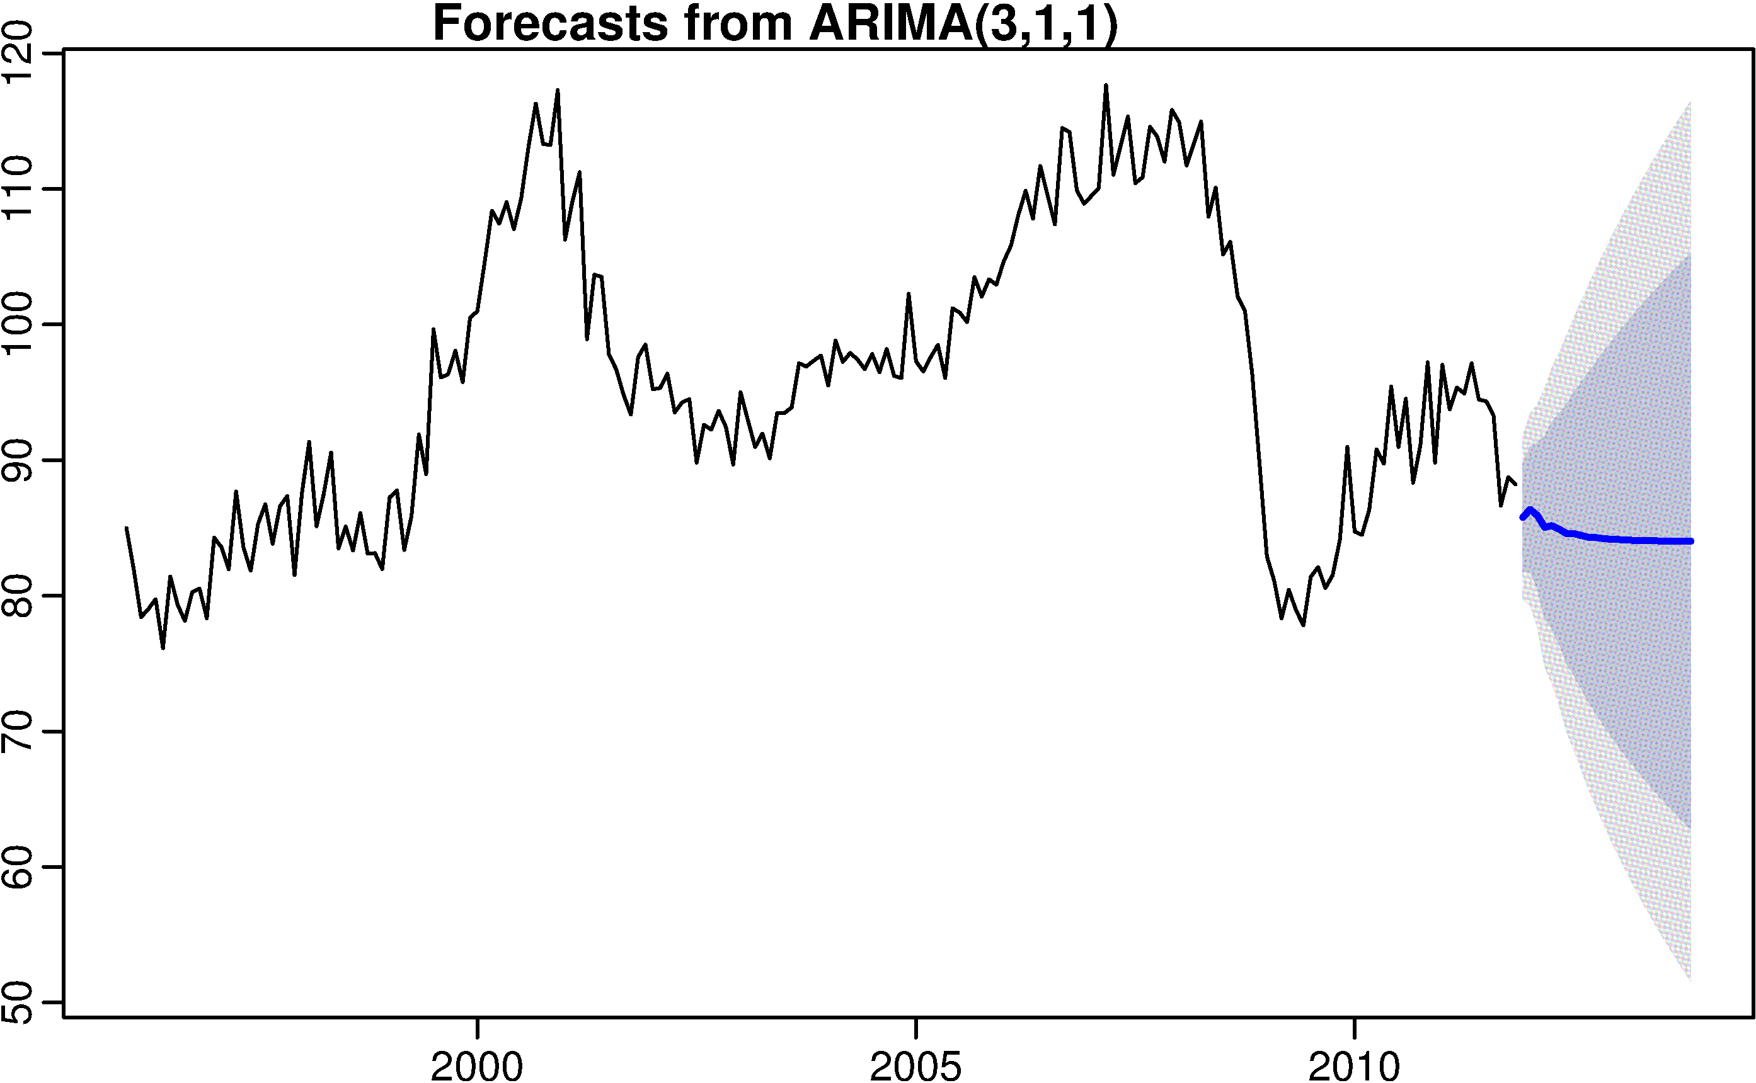
We didn’t talk about prediction!!!
Predict 1 point at a time
Horrible confidence intervals
Usefulness for predicting the future is suspect!
There is a huge random component to these models (otherwise we’d all be rich)

Slide 22
References
https://www.analyticsvidhya.com/blog/2016/02/time-series-forecasting-codes-python/
https://people.duke.edu/~rnau/411arim.htm
https://machinelearningmastery.com/arima-for-time-series-forecasting-with-python/
https://www.machinelearningplus.com/time-series/arima-model-time-series-forecasting-python/

